Slide 1
PSST Convention 2023 Karachi
Redefining of Sugar Industry
“An industrial Crux”
Presented
Mohammad Sarfaraz Khan
General Manager JK-1 Sugar Mills Khanewal
Former VP Engineering PSST (2017-19)

Slide 2
Introduction
Sustainability
Industry going in crunch phase needs sustainable & diversified measures to redefine its existence
Inflation
Cane inputs increased by 44.23%, while, Maintenance, Energy cost, over heads elevates to 30%. Therefore, Breakeven greatly agonize
Production cost projected to Rs. 146/kg at notified price of Rs. 425/ 40 kg of cane procurement (MSP) 2023-24
Currently, Sugar export has been stopped which remained 215,751 Tons during last fiscal year - 2022 & 5542 Tons during July -23

Slide 3
Cane Crop Overview
Potential
80 – 84 Million Metric Tons cane production annually
Facts
0.68% recovery & 20% yield loss in fields due to improper Pest Management activities & non-varietal procurement
Challenges
Sugar cane yield (50 T/ha) is at lowest level amongst world
A declared 8th most vulnerable country of world badly effected with Climate change
Compulsions
Procurement of Non-varietal, lodged, burnt & irrigated cane
Local issues, Enormous use of Nitrogenous fertilizer

Slide 5
PROVINCE WISE SHARING OF CANE PRODUCTION (%) Source: Provincial Agriculture Departments & (PSMA)

Slide 6
Notes:
Average input inflation 44.23%

Slide 7
Comparison of Minimum Support Price Vs Yield (Mounds) Earning/Acre
Reference notification (Sindh) Cane Price Rs. 425/40Kg (Season 2023-24)
Notes:
Its 44.23% increase in input cost from last year 2021-22

Slide 8
Notes:
19-21% cost contribution would compensate through by products Vs Cane procurement expanse

Slide 9
Industrial Challenges
Cane procurement share is approached to 80(±3%) of total expanse. However, sugar sale price always govern instead of free market flow
50% capacity utilization of sugar plants leads to an in-efficient operations from energy perspective & cane procurement costs
Cane payment are on weight basis instead of recovery ultimately impacts the financial equation of an industry. This has to be take up like other part of world for win-win regime

Slide 10
Industrial Challenges
0.15% recovery loss by extraneous matter for every 1% harvested cane at 10,000 TCD. While increased to 2-3% in last quarter of season
Every diversified activity has a definite cost of investment. However, 25% interest rate is matter of concerns to get it implement in these days
Being a declared climate change vulnerable country, for every 1 ^{O}C temp increase, sugar cane yield decrease by 10% is an alarming aspect

Slide 11
Notes:
5 times 10 plus recovery from 15 years, 33.33% matter of concern
Source: PSMA

Slide 12
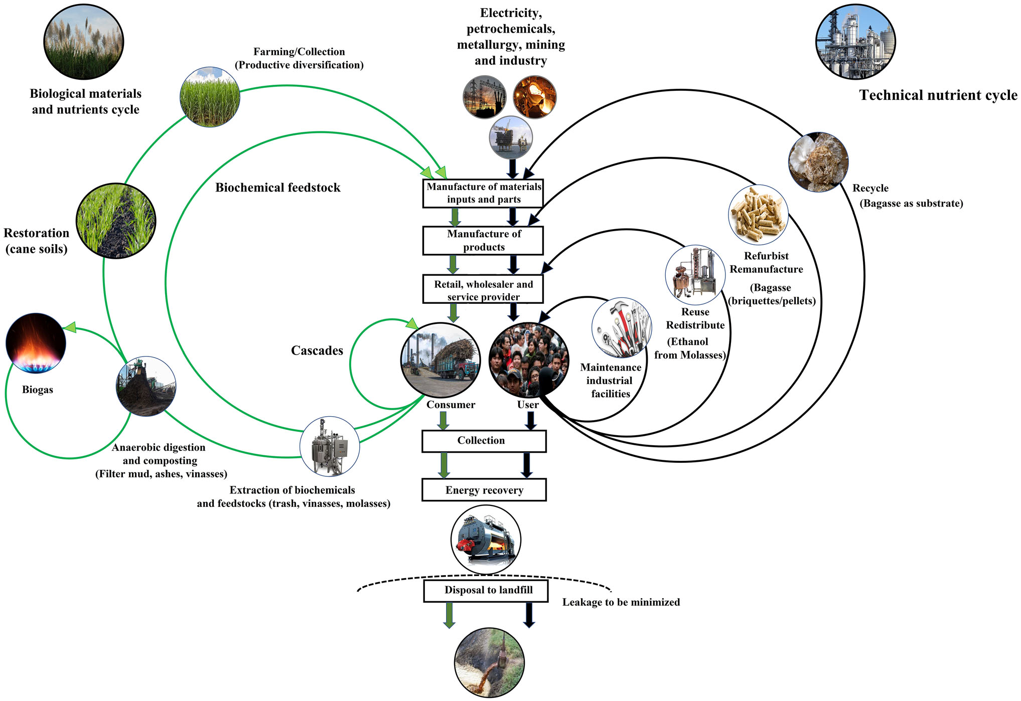
SUSTAINABLE CLOSED LOOP & ECONOMIC MODEL FOR SUGAR CANE AGRO INDUSTRY

Slide 13
BONSUCRO 3-dimensional perspective based on Economic, Environmental & Social compliance for sustainable sugarcane production & sugar manufacturing for beverage & corporate businesses. While, certified ethanol, molasses, direct sales are value additions.
Bonsucro promotes sugarcane growth sustainability
Biodiversity and ecosystem services
Works across sugarcane & its by products
Manage inputs, processing efficiencies to enhance sustainability
Respect labor Human rights
Value addition to final product
Continuously improve key area of business

Slide 14
Bonsucro integration to sustainability
20% reduction in GHG emissions
15% reduction in water consumption
30% decrease in fertilizer application
25% improvement in yield through nutrients & pest management
40% decrease in diesel consumption
9% decrease in mechanical tilled area
20% farmers switched to solar tube wells
Reduction in trash burning to ensures < 0.44 tons CO₂ emissions equivalent to per ton of sugar

Slide 15
Bonsucro at glance globally
27% global land while 72 MMT cane is Bonsucro certified which is equal to 86% cane & 63% sugar production of Pakistan
4 Million tons of Bonsucro certified sugar produced through 31 certified mills & 13 countries
2.5 Million Cubic meter Bonsucro ethanol
1 credit is equals to 1 ton of Bonsucro certified product i.e. sugar cane, raw sugar, molasses & ethanol
64% small holder farmers capacity building of Pakistan directly relates to Bonsucro cultivation

Slide 16
DIVERSIFIED OPPORTUNITIES
Sugar Cane
Consumption
Milling
Bagasse
Energy
Sugar Cane Juice
Bagasse Ash
Purification
Press Mud
Sugar
Molasses
Fermentation and Distillation
Vinasse
Alcohol
Spent Wash

Slide 17
Revenue generation status of industry

Slide 18
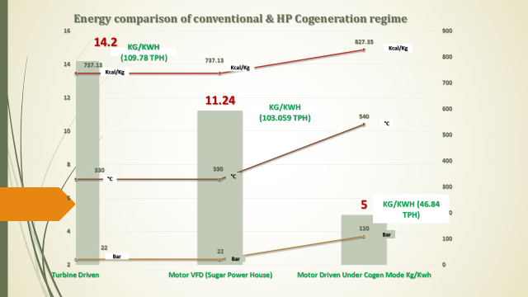
Diversified Opportunities ( Bagasse based)
Cogeneration is value addition to bagasse with quantum of 1000 MW potential. Only 200 MW synchronized to National Grid @ 20% max due to typical hindrance of tariff determination, delayed payment, bagasse prices and system synchronization. Energy comparison reflected at different modes of steam consumption Vs Cogen

Slide 19
Bagasse based diversified opportunities
Induction of HP boilers in existing plants to improve energy cycle by 10 -15%
HP TG Set use to curtail energy requirements through motorized regime at milling
Overall bagasse saving potential for country @ 13 -15% of total bagasse production 3.6 to 4 MMT can be realized for bio mass fuel opportunity.
Other choices; Harvested fields left over Top & Trash @ 0.14% per ton of cane which is also bio fuel opportunity to mix it with bagasse @ 10 -15% to economize fuel combustion and enhance productivity.
Ash produce1.5 - 3% on bagasse combustion, while 0.09MMT can realize @ 2.25% (Avg) as value addition to use at construction industry.
MDF (Medium density fiberboard)
Paper industry

Slide 20
Notes:
Bagasse availability

Slide 21
MOLASSES DIVERSIFICATION
Country wide annual production 3.6 - 3.8 Million Tons @ 4.5%
Diversify to industrial alcohol , Ethanol, Vinasse , Spent wash & direct sales
Direct sales Rs. 40,000 per ton during 2022-23 season
Distilleries integration or direct molasses exports an advantageous USD exchange
Distilleries operations especially in off season facilitates the allied sugar plants for their off season power requirements to economize utility bills and ensures un-interruptible supplies. However, its waste disposal is an integral aspect to ensure CSR compliance
Significantly, 2021 country exported USD 389 (Million) un-denatured ethyl alcohol being the 7th largest exporter of world with 80% volume.

Slide 22
Notes:
Direct export of molasses @ 5-6% of production
9.16% increase in direct sales price in year 2022-23 Vs 2021-22
Ref (PSMA – Annual 2022)

Slide 23
Notes:
Ref (PSMA – Annual 2022)
Unit ton of molasses produce 10.8 Liters of Ethanol @ 1.08%

Slide 24
FILTER MUD VALUE ADDITION
By & large ethically, an organic material use to recycle for crop productivity and field return mechanism.
Estimated @ 3% on cane produced 2.43 million tons annually
Significantly, couple of years wet mud direct sale on actual weight realize 3.64 million tons @ 4.5%
1.21 million tons can be added for extra 1.5% in the profitability from estimation to actual weight sale
Direct sales for year the 2022-23 @ Rs. 1600 a valuable opportunity without investment.

Slide 25
Sugar consumptions, Stocks projections Demand & Supply perspective 2023-24

Slide 27
Sugarcane Production, Supply and Distribution (1000 HA), (1000 MT)
Sugarcane | 2021/2022 |  | 2022/2023 |  | 2023/2024
Market Year Begins | Oct 2021 |  | Oct 2022 |  | Oct 2023
Pakistan Sugar Cane production | USDA Official 89000 | New Post 89000 | USDA Official 82400 | New Post 81000 | USDA Official | New Post 83500*
Bagging Stocks | 2752 | 2752 | 3392 | 3812 | 0 | 3352
Beet Sugar Production | 60 | 60 | 60 | 60 | 0 | 60
Cane Sugar Production | 7080 | 7500 | 7000 | 6800 | 0 | 7050
Total Sugar Production | 7140 | 7560 | 7060 | 6860 | 0 | 7110*
Raw Imports | 0 | 0 | 0 | 0 | 0 | 0
Refined Lamp | 0 | 0 | 0 | 0 | 0 | 0
Total Imports | 0 | 0 | 0 | 0 | 0 | 0
Total Supply | 9892 | 10312 | 10452 | 10672 | 0 | 10632
Raw Exports | 0 | 0 | 0 | 0 | 0 | 0
Refined Exp. (Raw Val) | 500 | 500 | 1000 | 1000 | 0 | 800
Total Exports | 500 | 500 | 1000 | 1000 | 0 | 800
Human Dom. Consumption | 6000 | 6000 | 6100 | 6150 | 0 | 6300
Other Disappearance | 0 | 0 | 0 | 0 | 0 | 0
Total Use | 6000 | 6000 | 6100 | 6150 | 0 | 6300*
Ending Stocks (Carry forward) | 3392 | 3812 | 3352 | 3522 | 0 | 3532*
Total Distribution Ref: (USDA, GAIN) * (Forecast) | 9892 | 10312 | 10452 | 10672 | 0 | 10632*
Notes:
GAIN (Global agriculture information network)
USDA (US department of Agriculture) Foreign agriculture services
27.11 kg/capita consumption

Slide 28
Recommendations Agriculture sustainability & phase wise diversification is order of day to gear up industrial stability.

Slide 29
Thank You!

